Slide 1
Analysis Week 6

Slide 2
Types of Analysis
Qualitative
Quantitative
What did the reading have to say about these?

Slide 3
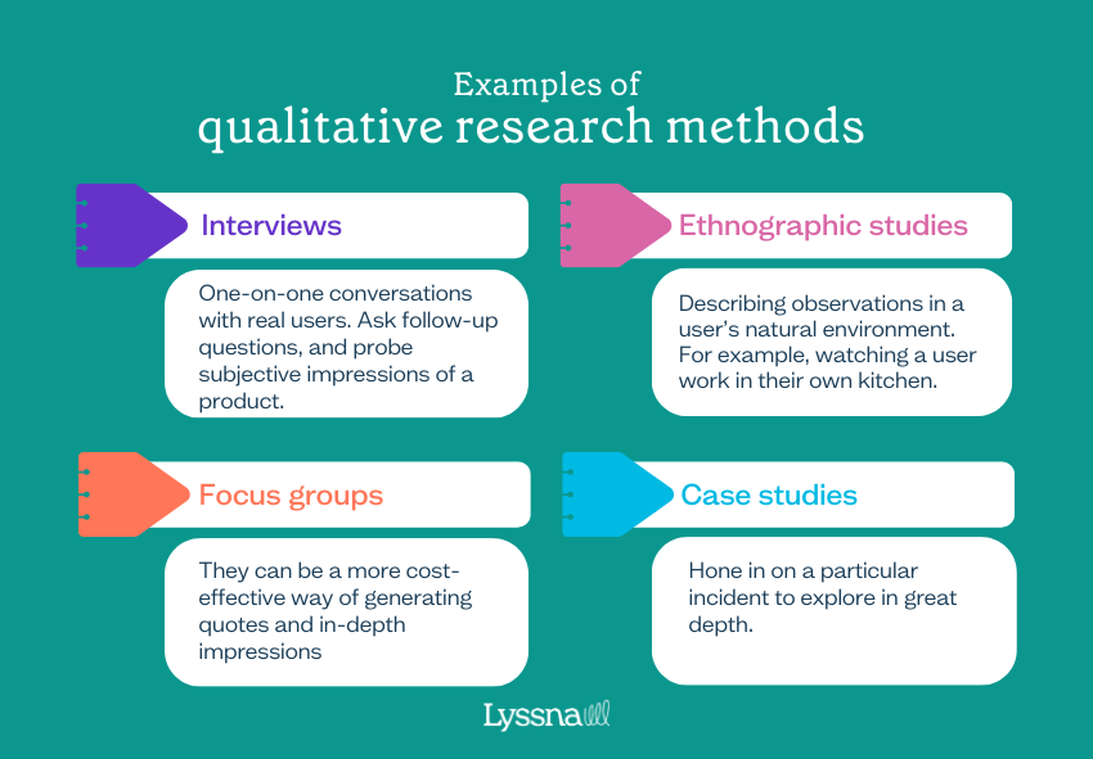
Notes:
https://www.lyssna.com/blog/qualitative-vs-quantitative-research/
Generally about working with messy, case study oriented, experiental evidence. Slow

Slide 4
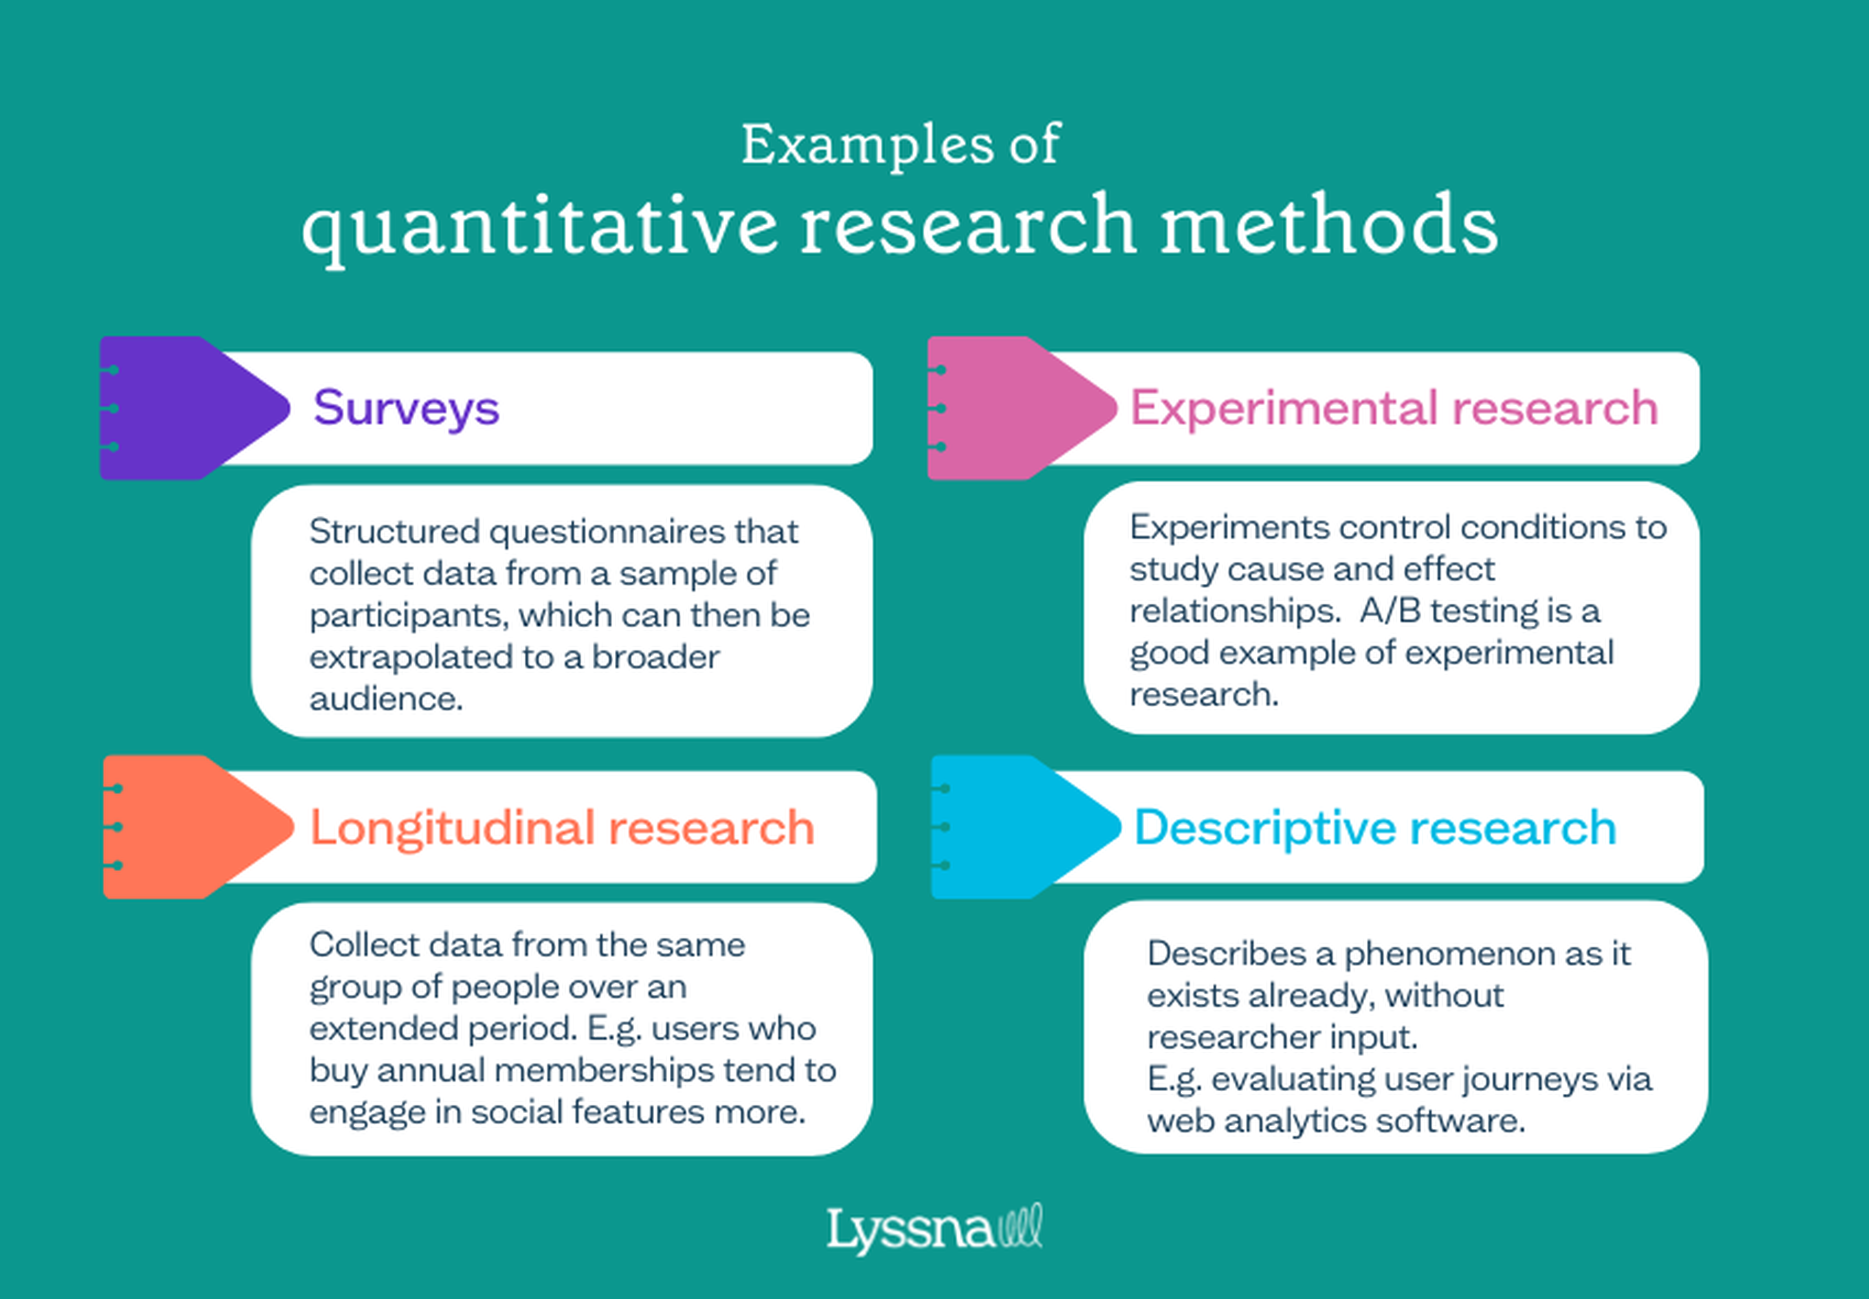
Notes:
From https://www.lyssna.com/blog/qualitative-vs-quantitative-research/
Measurable, at scale, takes a long time

Slide 5
Types of Analysis
Qualitative
Quantitative
Exploratory
Explanatory

Slide 6
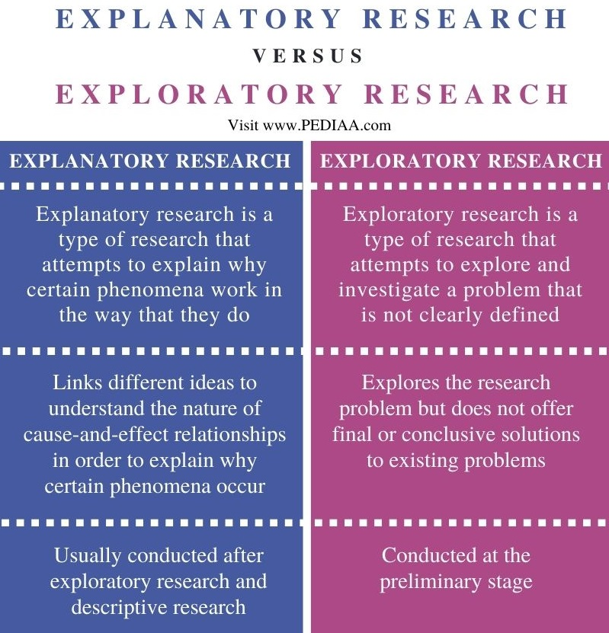
Notes:
https://userinput.io/customer-research/exploratory-vs-explanatory-research/

Slide 7

Notes:
https://slideplayer.com/slide/10513247/

Slide 8
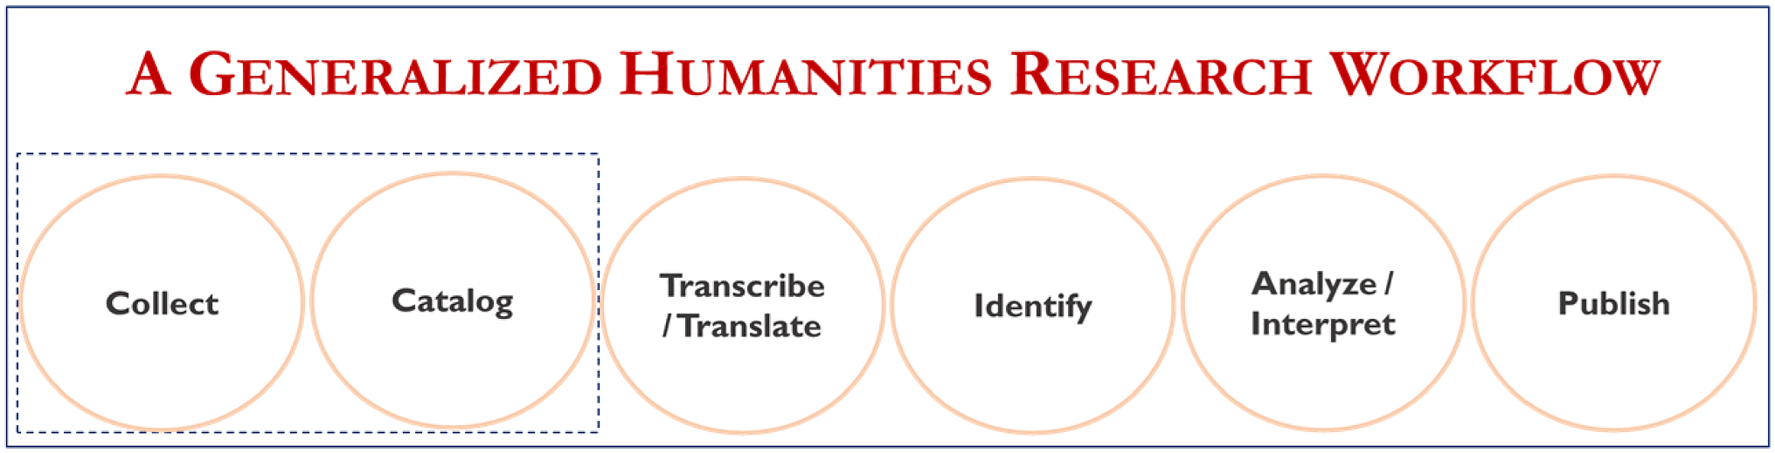
Notes:
https://www.researchgate.net/figure/A-generalized-humanities-research-workflow-It-contains-six-circles-to-represent-the_fig1_364245293

Slide 9
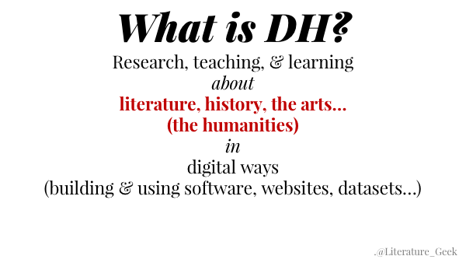

Slide 10
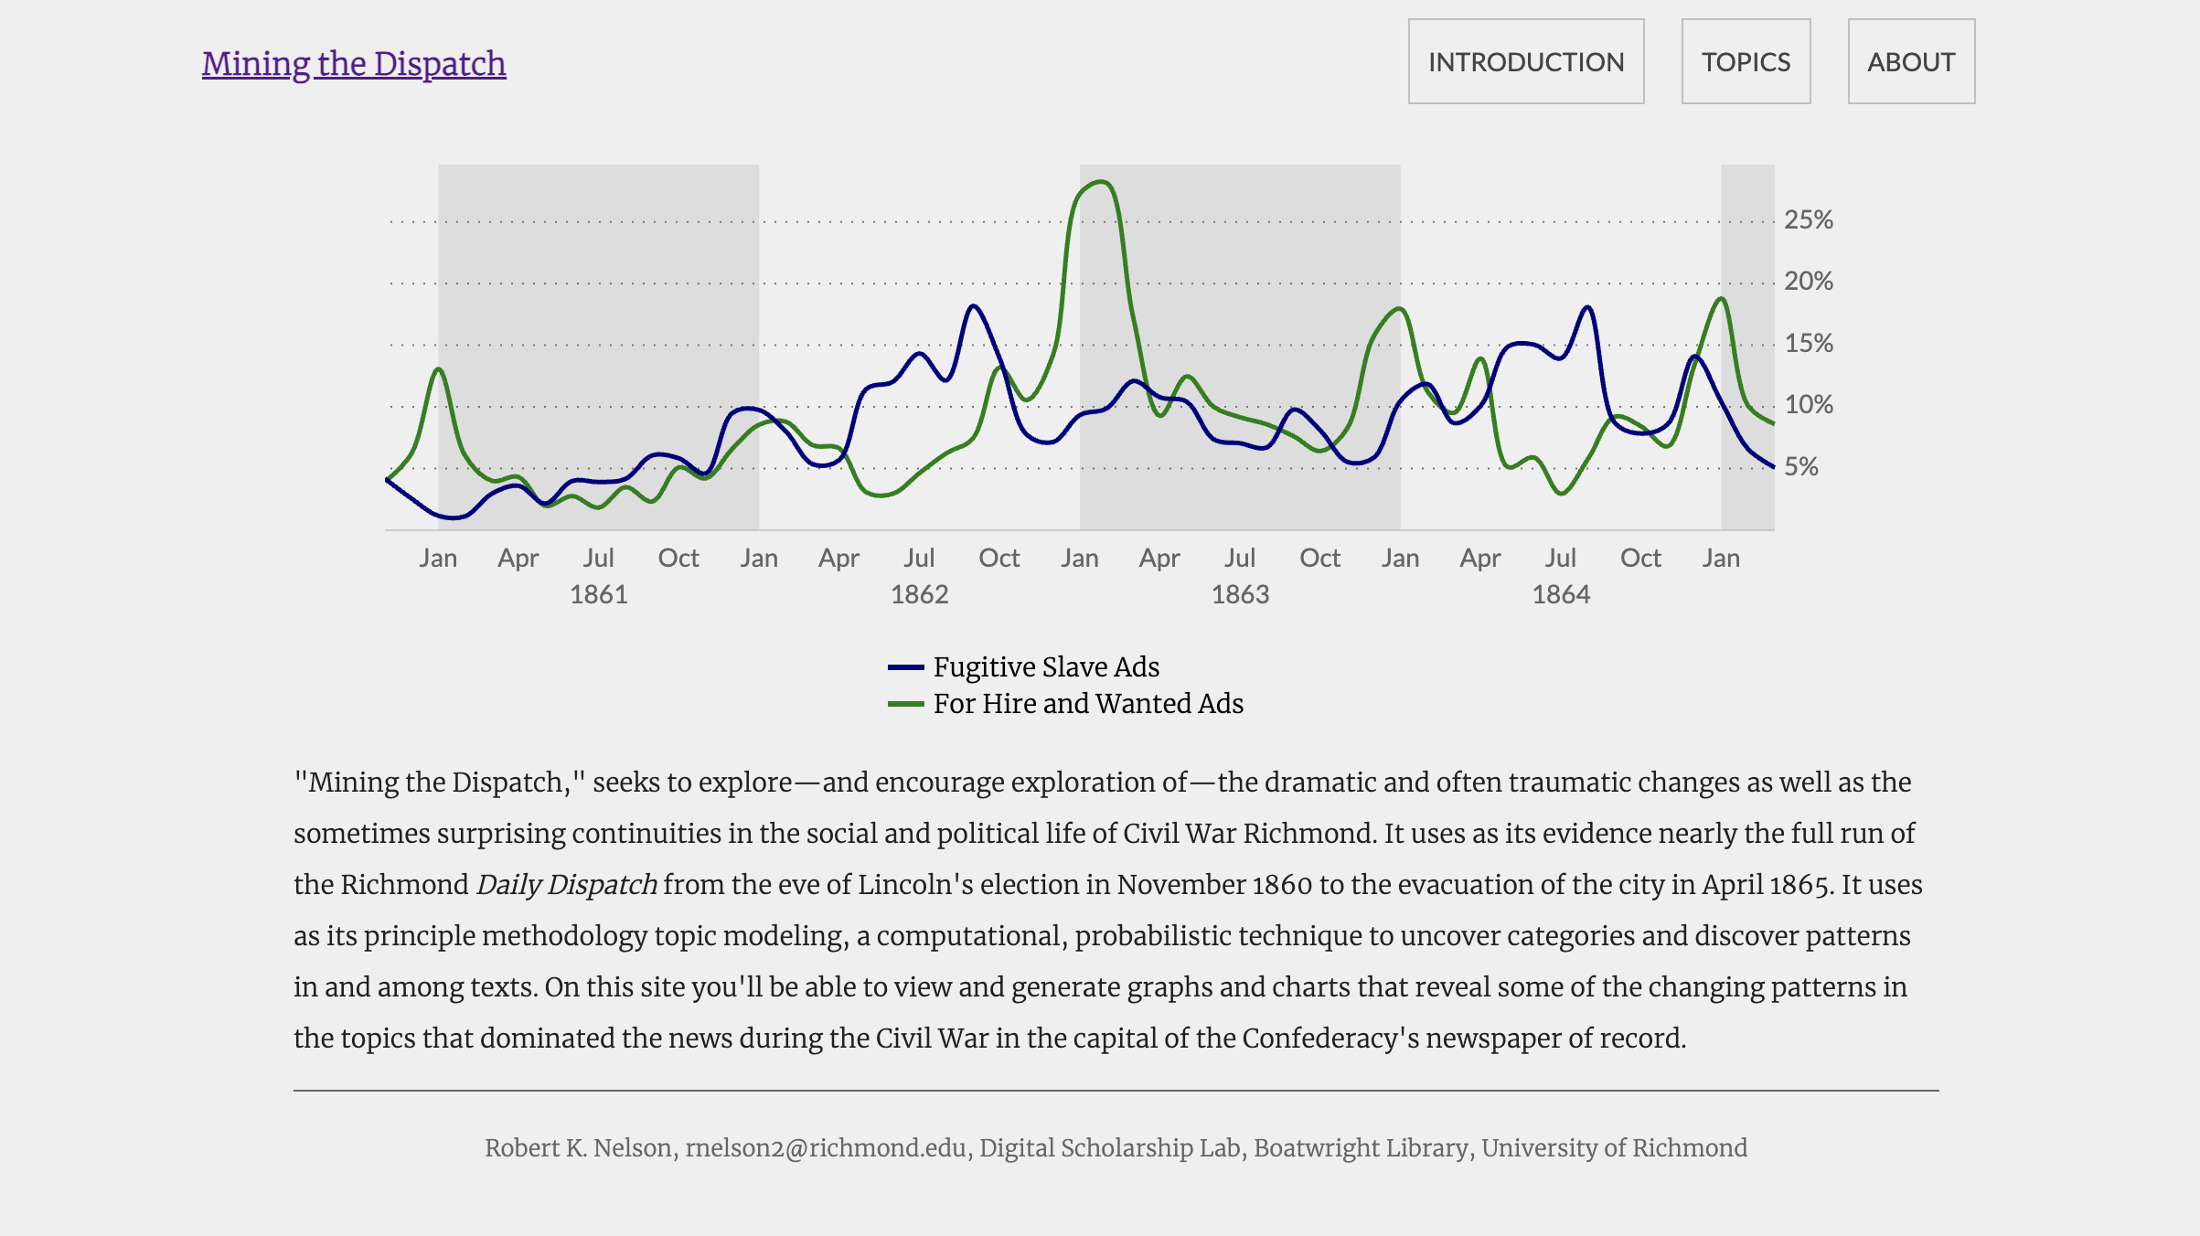
Notes:
https://dsl.richmond.edu/dispatch/

Slide 11
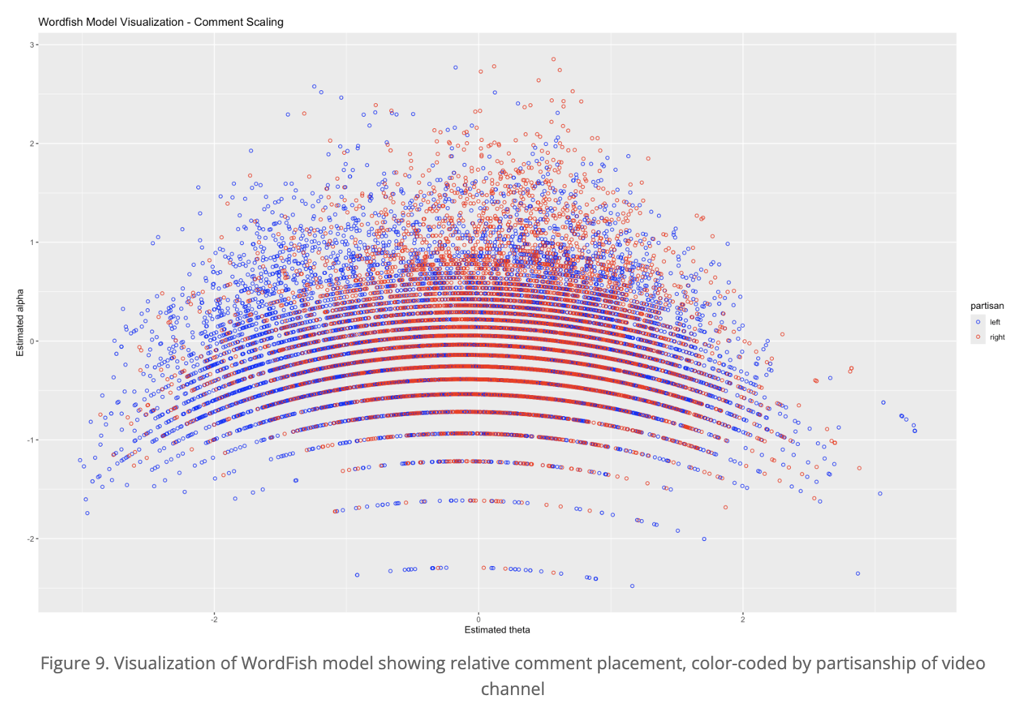
Notes:
https://programminghistorian.org/en/lessons/text-mining-youtube-comments
Using a particular software package to code youtube comments for their political leanings

Slide 12
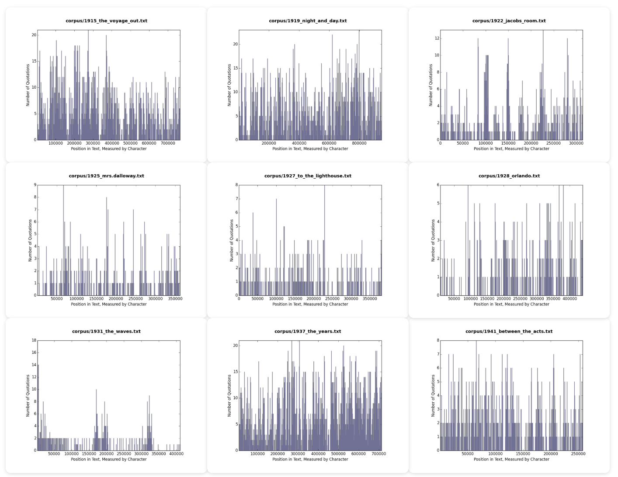

Slide 13
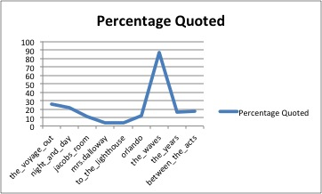

Slide 14
Looker Studio
Data analysis is a HUGE area – we are going to just scratch the surface
Often requires programming
Limited here by
Experience
Technical skill
Cost of tools
Why we aren’t using MS PowerBI (as was in the course description!)

Slide 15
Types of Analysis
Qualitative
Quantitative
Exploratory
Explanatory
Consider all of these as you work towards final projects.
What story are you trying to tell? It can change in the telling!

Slide 16
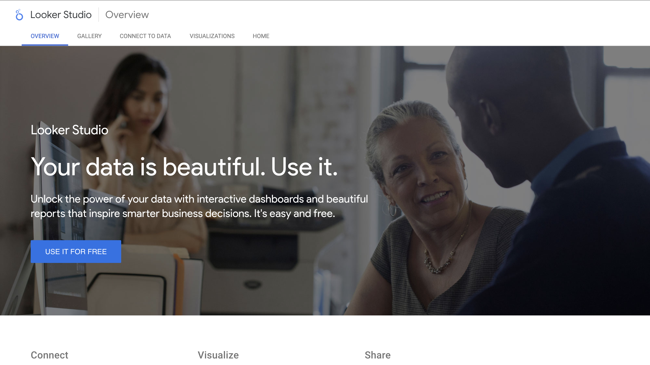

Slide 17
Plan
Upload our data to google sheets
Make a looker studio project
Embed a table
Make a line graph
Make a scatterplot
Play in groups
Share

Slide 18
Upload our Data to Google Sheets
Will require a gmail account
Doesn’t have to be your real one
One of the tradeoffs here – this is free because google wants your data
Go to sheets.new in a browser.
File -> import -> upload from your computer
Upload the audible cleaned dataset.
Should now be part of your google drive account

Slide 19
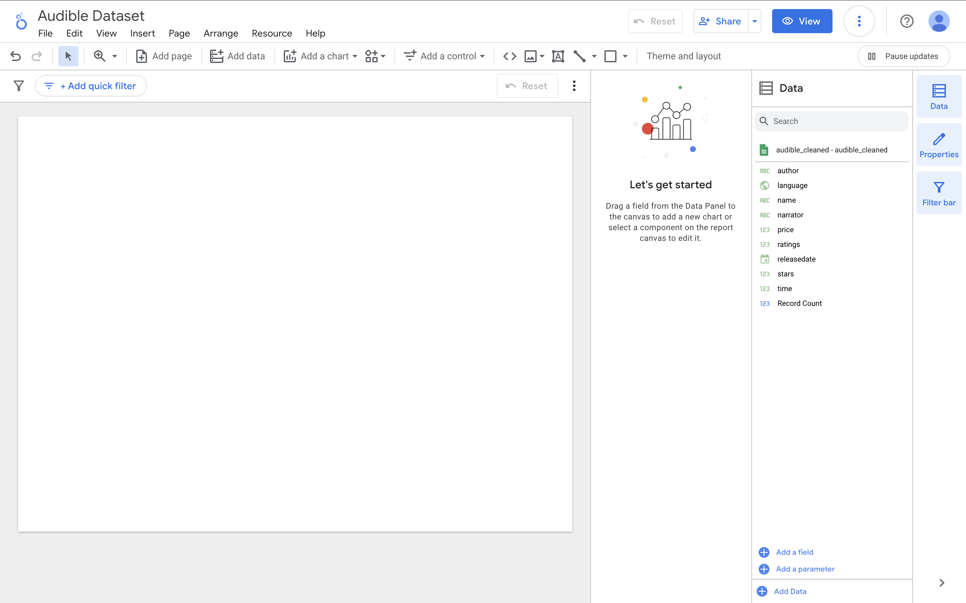
Make a New Project and Add Our Data
https://lookerstudio.google.com/
Click new blank project
Will ask you to give a location and company
But then at the end of the day should bring you here
Click “add data”
Click google sheets
You should be able to find the audible dataset if it’s on your google drive
Now we have our audible data in the report

Slide 20
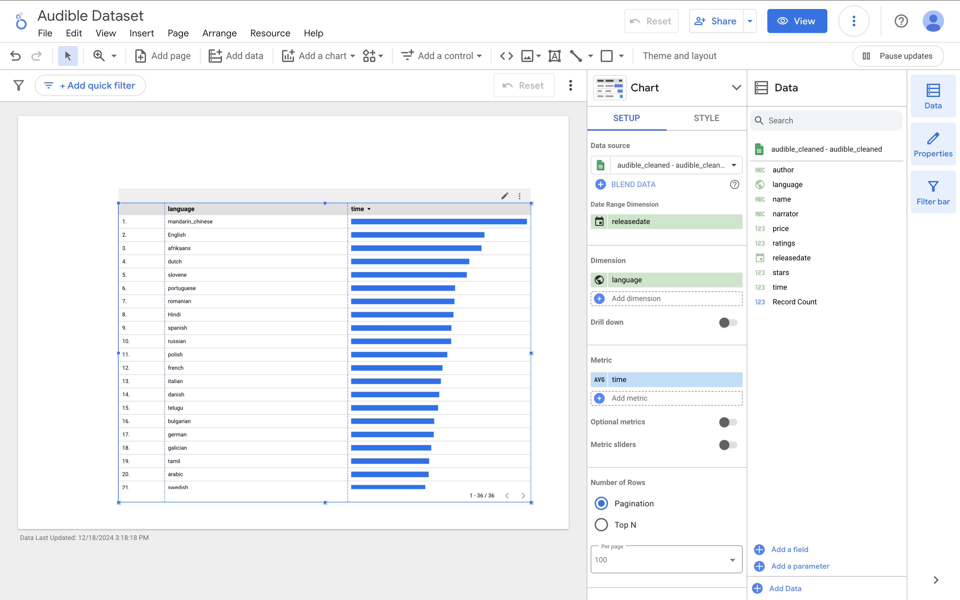
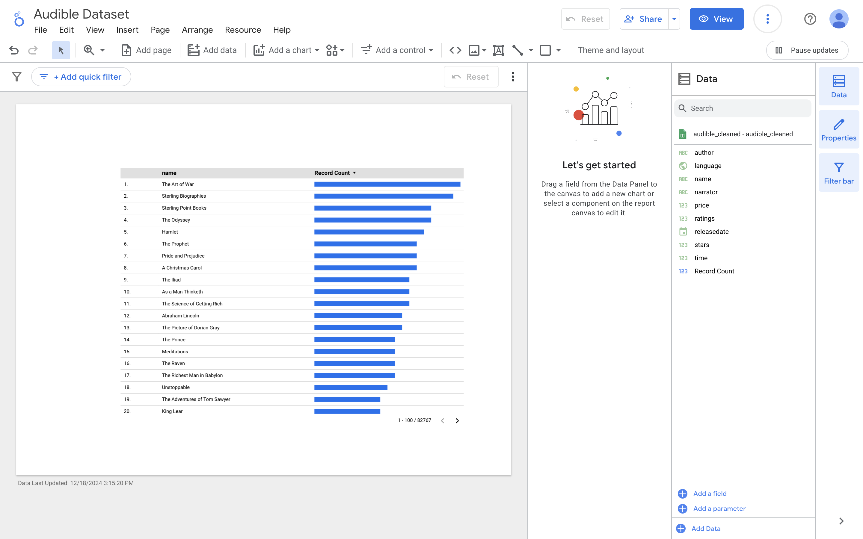
Adding a Table
Click “add a chart” ->“Table with Bars” and place your chart in one corner of the report.
Note the dimensions and axes if gives you by default – you will often want to change them.
By default I got a chart of most common authors (you might have gotten something else). Let’s modify settings from top to bottom.
Dimension = language.
Metric Avg instead of sum or aut
Pay attention not just to the metrics but also to whether they are raw counts/sums/avg
Result is that we have a graph for how long, on average, the typical audiobooks are for each language

Slide 21
Filtering
When you load in your data it should give you table of the results by default.
Everything is connected, so if we click a language row from our new visualization it will update the table.
I.e. if we click “French” it will show us the longest French novels in the collection.
Play around a second and see if you notice anything else interesting.

Slide 22
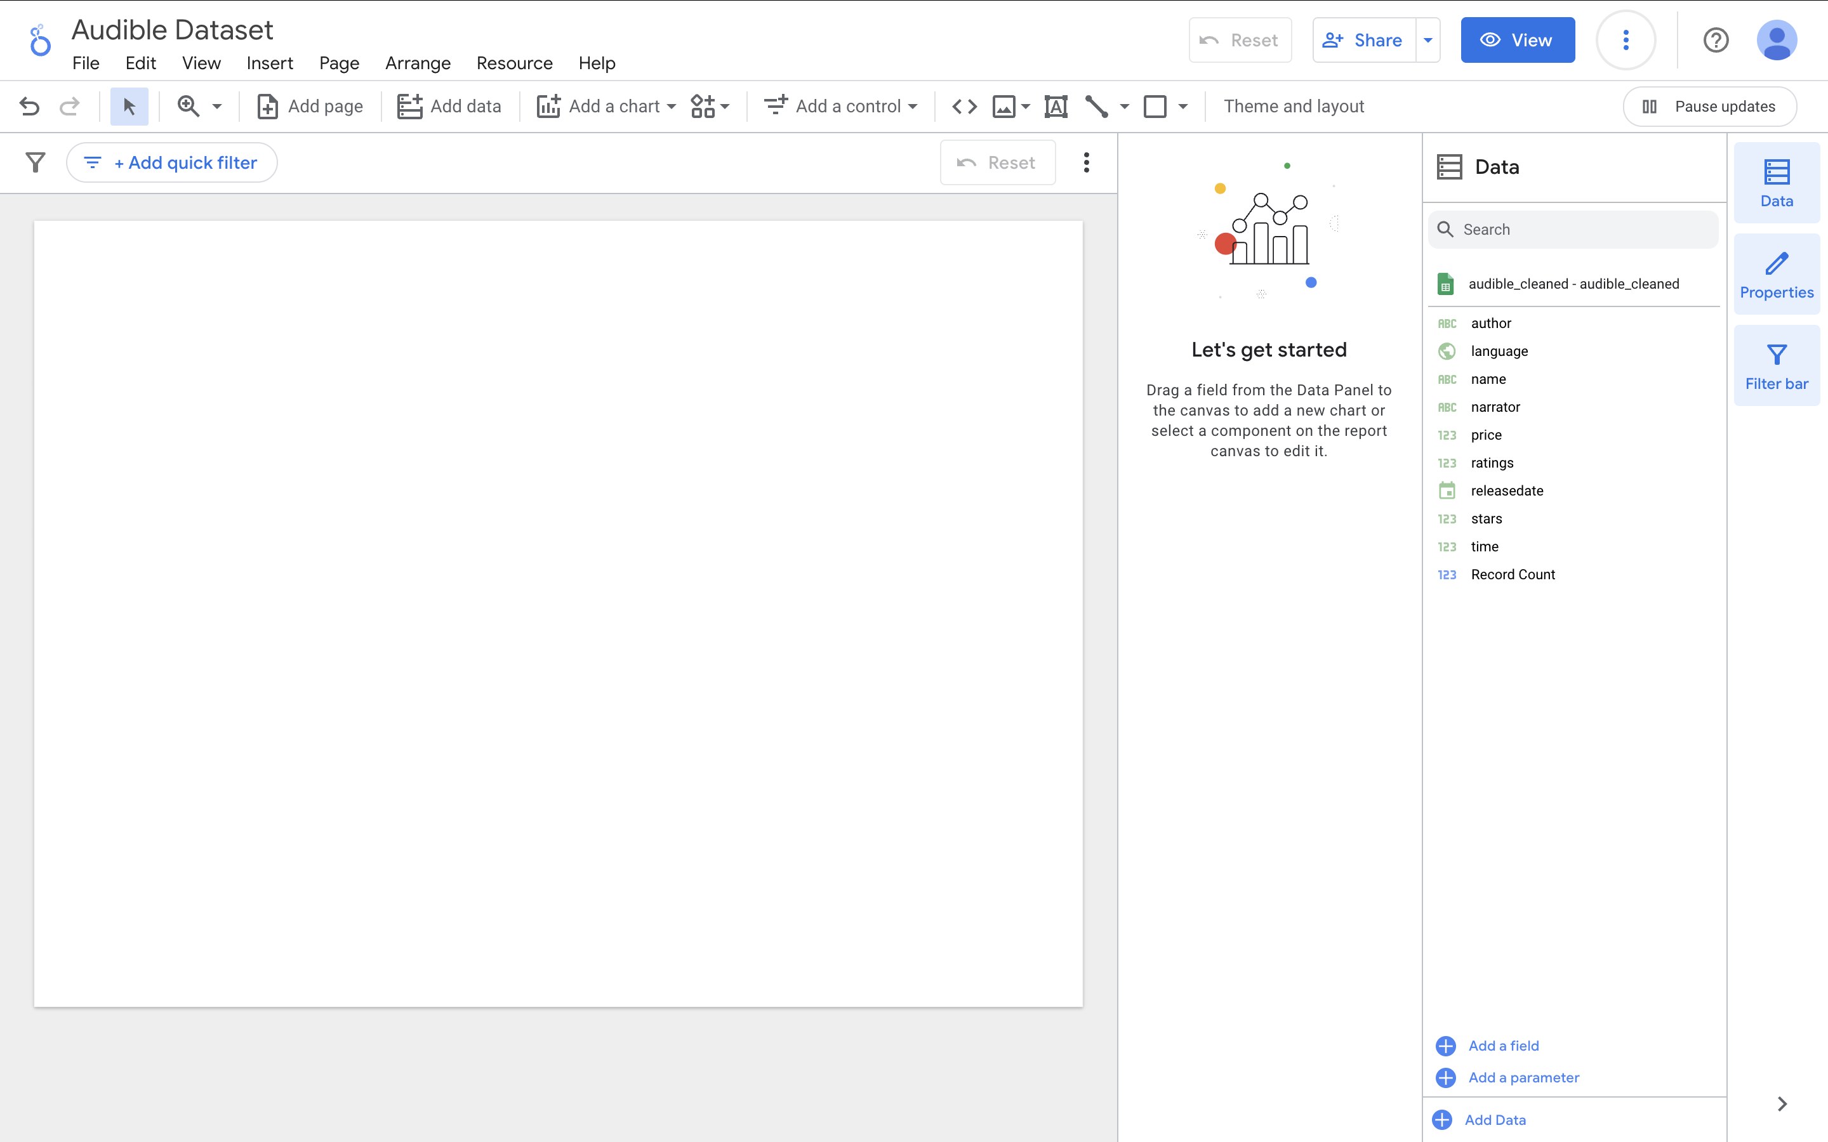
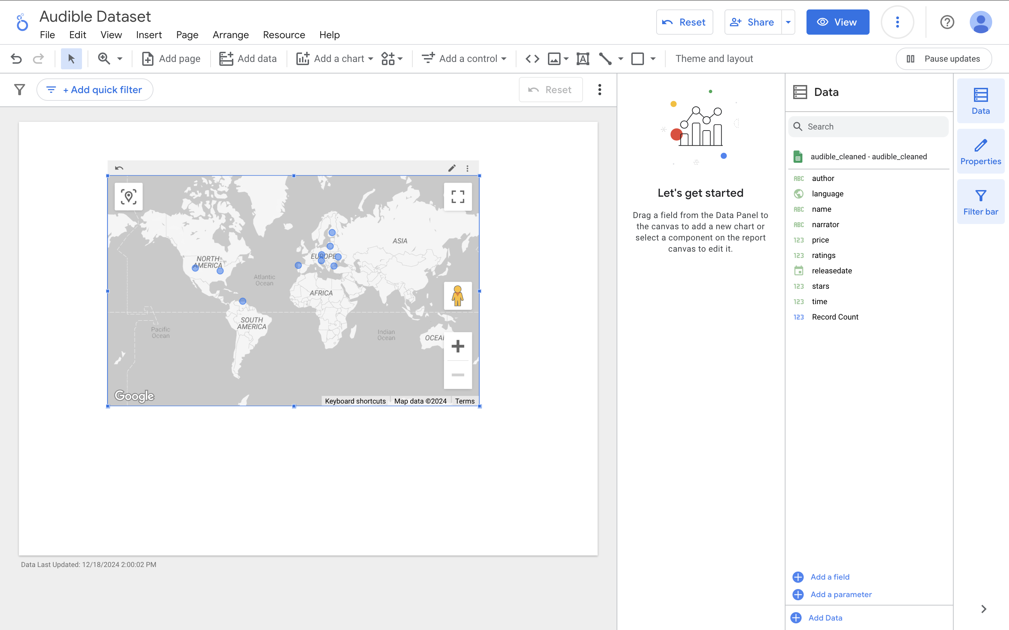
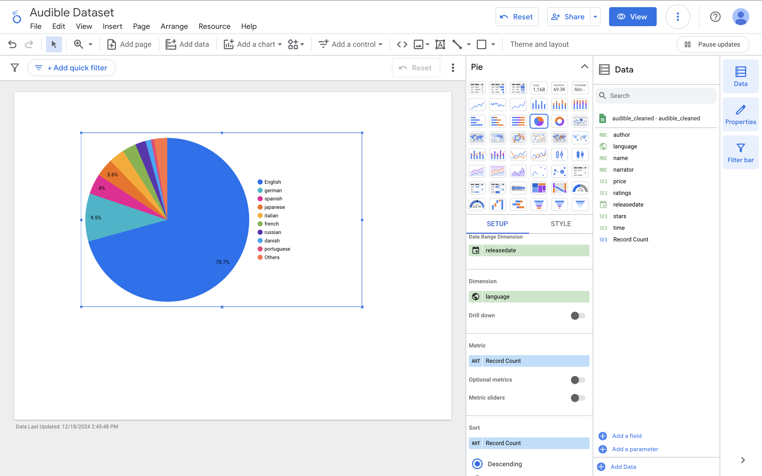
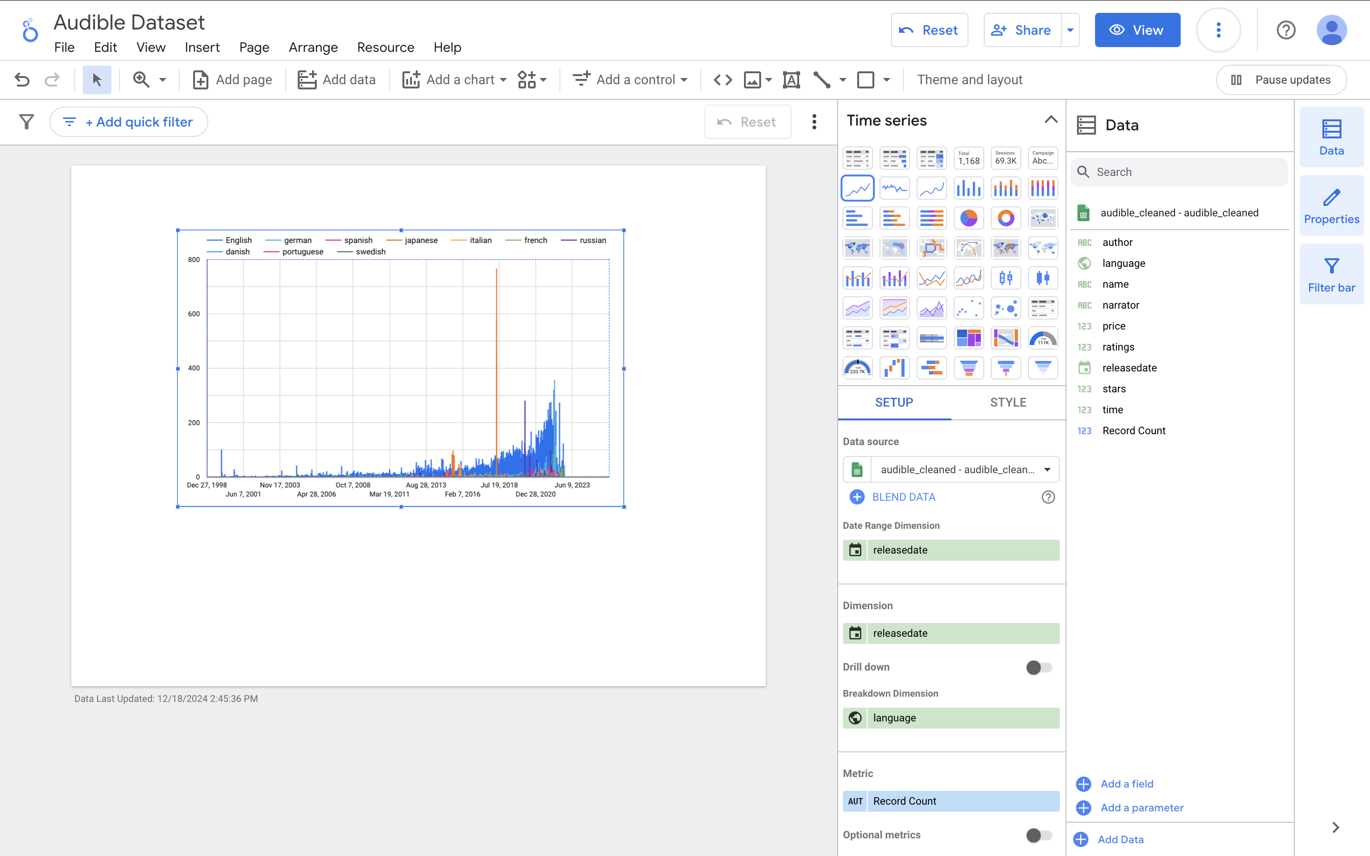
Language Graphing
Drag a data field over. Let’s grab “language”
Expand the chart and click it
Change it to a pie chart
Then again to a time series
Google will infer a lot!
Play for a moment

Slide 23
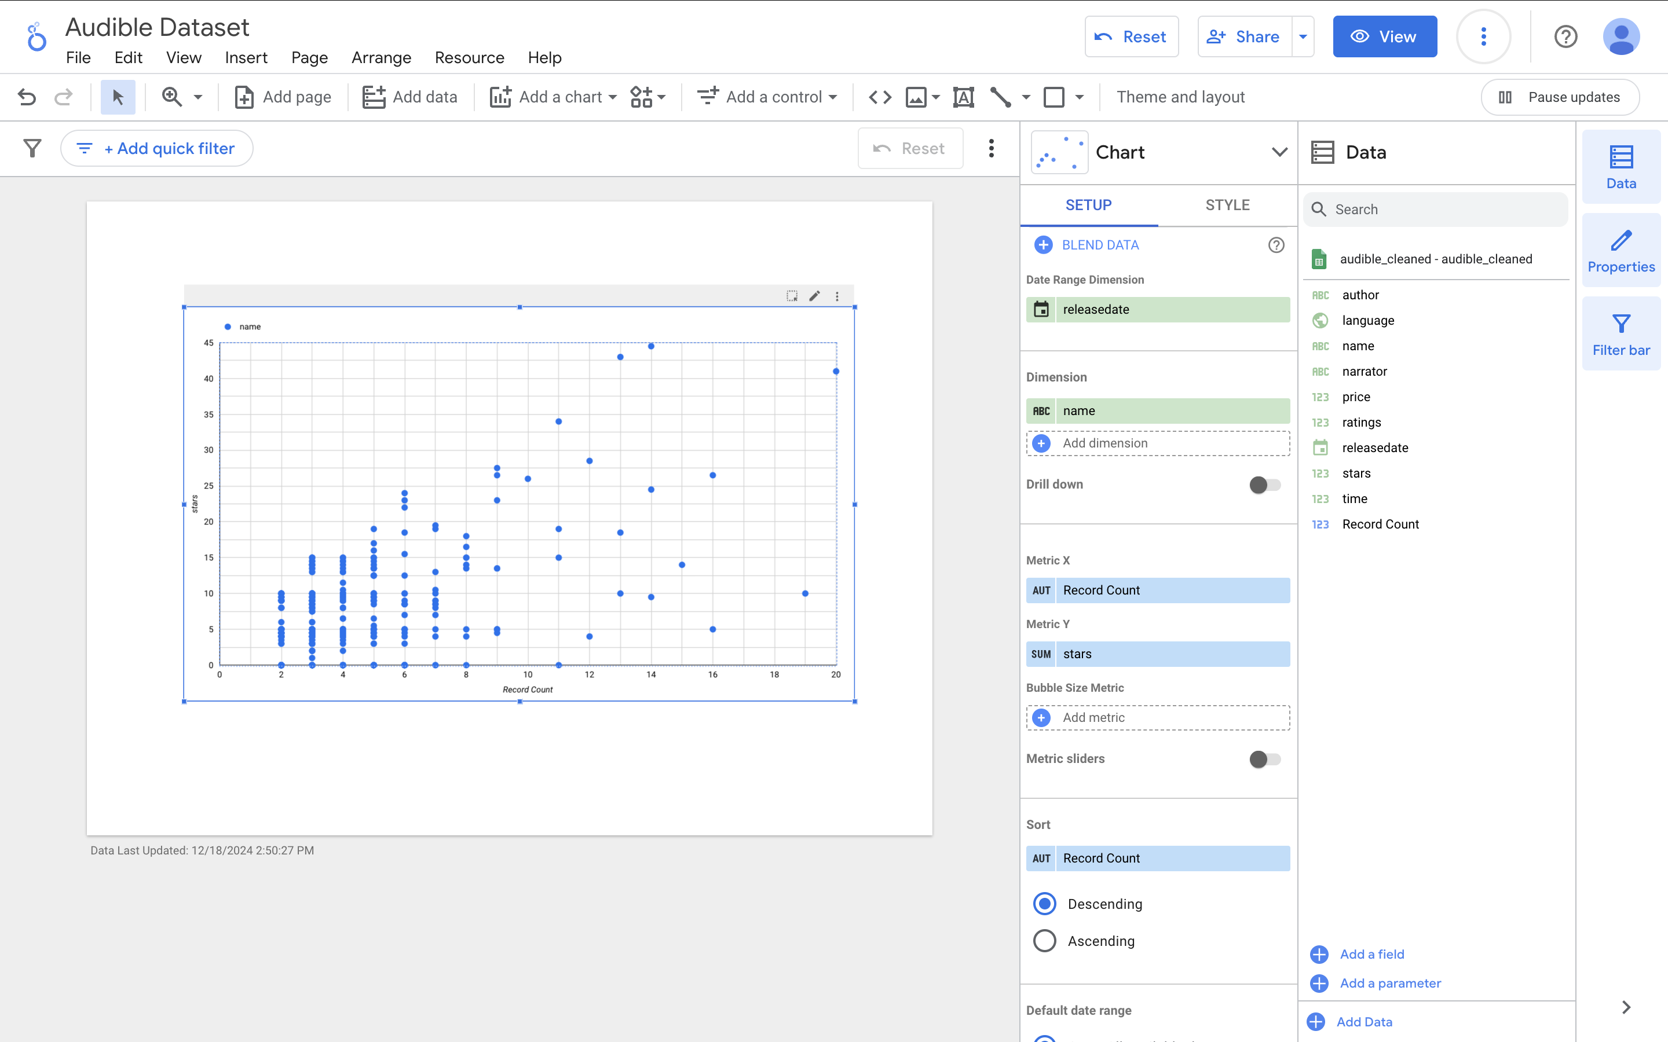
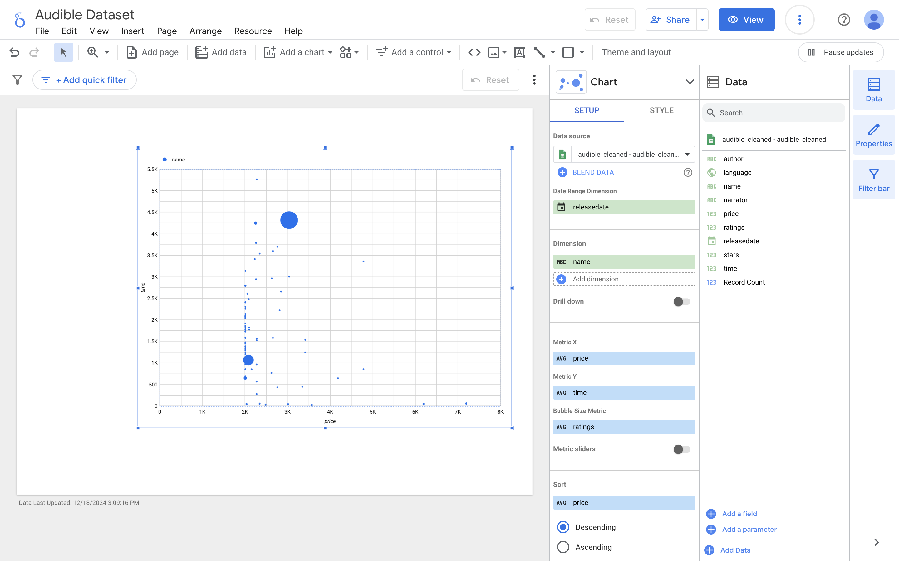
Adding a Scatterplot
Click “add a chart”
Scroll and select “scatter”
Note the dimensions and axes we want to change them.
Dimension: name
X: avg – price
Y: avg – time
Try playing around by changing these values and also the style menu
Any concerns or thoughts? What do you notice?
Notes:
What is the price unit? The time unit?

Slide 24
Work Time
In small groups play with the tool and see what you can do!
I’ll float to help
In the last few minutes we will share what you come up with with one twist:
We want you to walk through the class how to produce the same visualization.
What do you want to do that you can’t figure out?

Slide 25
Homework
Use Looker Studio to tell a story about the audible dataset. By 9:00 AM Friday send me a paragraph describing what you see and a screenshot of any visualization that is meaningful to you.

